Slide 1

Threads
PASS
CS532: OS Foundations
Lab Assignment
Email: chitram2@pdx.edu & ramya3@pdx.edu

Slide 2
Instructions: Make a copy of this document, move your copy to your submissions folder and fill the document with your responses. Use the space on each slide to show your responses, and add additional slides as needed.
When ready for grading: complete the lab assignment submission form and include a link to your filled document

Slide 3
sum.c
Your assignment is to read, understand, build, run and improve the sum.c program. Begin by reading and understanding the sum.c source code which is linked from the course plan document.
Next, build and run the original sum.c program as described in the source code. When you run the original version it should fail!

Slide 4
1. Why does the original sum program fail? What is wrong with it?
Several threads are modifying the same data (ROUND), which causes the initial sum program to fail. And as a result, the summing threads did not run for the appropriate number of loops, which causes the summation to be incorrect.

Slide 5
2. Modify the sum.c source code to create a new version named sum2.c that calculates the sums correctly and consistently using multiple threads. Test sum2 with 4 threads and various numbers of Rounds such as 2, 20, 200, 2000. Keep the code INEFFICIENT in that every thread updates the global Total on every iteration of its inner loop. If your code takes longer than 2 minutes to run, then stop it and run with a lower number of Rounds.
Upload your sum2.c file to your submissions folder and provide a link to it here: link
https://docs.google.com/document/d/1JJQ3j6hMB6sM9C_q0JzfsGc1pBie-duG/edit

Slide 6
#include <stdlib.h>
#include <unistd.h>
#define MAXTHREADS 10
volatile unsigned long long Round = 0ULL;
volatile unsigned long long Total = 0ULL;
pthread_mutex_t sum_mutex1 = PTHREAD_MUTEX_INITIALIZER;
void *Summation(void *tidptr)
{
unsigned long long tid = * ((unsigned long long*) tidptr);
for (unsigned long long dex = 0ULL; dex <= tid; dex++) {
pthread_mutex_lock(&sum_mutex1);
Total += dex;
pthread_mutex_unlock(&sum_mutex1);
}
return NULL;
}
void doOneRound(unsigned long long thisRound, int numthreads)
{
int tids[MAXTHREADS] = {0,1,2,3,4,5,6,7,8,9};
pthread_t t[numthreads];
int rc;
/* start all of the threads */
for (int i = 0; i < numthreads; i++) {
rc = pthread_create(&t[i], NULL, Summation, (void *) &thisRound);
if (rc){
printf("ERROR; return code from pthread_create() is %d\n", rc);
exit(-1);
}
}

Slide 7
/* wait for threads to complete */
for (int i = 0; i < numthreads; i++) {
rc = pthread_join(t[i], NULL);
if (rc != 0) {
fprintf(stderr, "ERROR joining with thread %d (error==%d)\n", tids[i], rc);
exit(-1);
}
}
}
void checkResult(unsigned long long thisRound, int numthreads)
{
unsigned long long calc = (thisRound * (thisRound + 1ULL)) / 2ULL;
calc *= (unsigned long long) numthreads;
if (Total != calc) {
printf("PARENT: ERROR! Round %llu total should have been %llu but was %llu\n", thisRound, calc, Total);
exit(-1);
}
}
int main(int argc, char *argv[])
{
if (argc != 3) {
fprintf(stderr, "USAGE: %s <nthreads> <max>\n", argv[0]);
exit(-1);
}
int numthreads = atoi(argv[1]);
if ((numthreads < 1) || (numthreads > MAXTHREADS)) {
fprintf(stderr, "ERROR: numthreads must be >= 1 and <= %d\n", MAXTHREADS);
exit(-1);
}

Slide 8
unsigned long long numrounds = strtoull(argv[2], NULL, 0);
if (numrounds <= 0ULL) {
fprintf(stderr, "ERROR: number of rounds must be a positive unsigned long long (not '%s')\n", argv[2]);
exit(-1);
}
printf("PARENT: input %d threads %llu rounds\n", numthreads, numrounds);
for (Round = 1ULL; Round < numrounds; Round++) {
Total = 0ULL;
doOneRound(Round, numthreads);
checkResult(Round, numthreads);
}
printf("PARENT: SUCCESS! exiting after final Round %llu (Total: %llu)\n", numrounds-1, Total);
return(0);
}

Slide 9
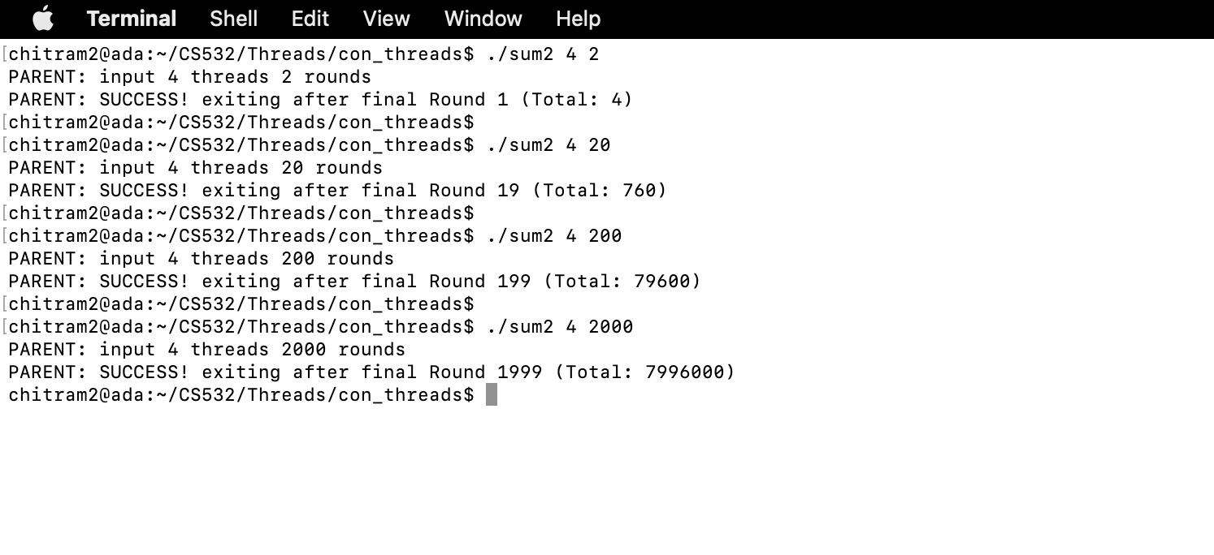

Slide 10
3. Improve your sum2.c source code to produce a new version, called sum3.c, that is more efficient in that each thread calculates its local sum and then modifies the shared Total variable when finished calculating its local total.
Build, Run, Test and Upload sum3.c to your submissions folder and provide a link to it here: link
https://docs.google.com/document/d/1Lfg27x28BUgF4igP6aFb8izrTZDoO3M3/edit
Code looks good

Slide 11
#define MAXTHREADS 10
volatile unsigned long long Round = 0ULL;
volatile unsigned long long Total = 0ULL;
pthread_mutex_t sum_mutex1 = PTHREAD_MUTEX_INITIALIZER;
void *Summation(void *tidptr)
{
unsigned long long local_total = 0;
unsigned long long tid = * ((unsigned long long*) tidptr);
for (unsigned long long dex = 0ULL; dex <= tid; dex++) {
local_total += dex;
}
pthread_mutex_lock(&sum_mutex1);
Total += local_total;
pthread_mutex_unlock(&sum_mutex1);
return NULL;
}
void doOneRound(unsigned long long thisRound, int numthreads)
{
int tids[MAXTHREADS] = {0,1,2,3,4,5,6,7,8,9};
pthread_t t[numthreads];
int rc;
/* start all of the threads */
for (int i = 0; i < numthreads; i++) {
rc = pthread_create(&t[i], NULL, Summation, (void *) &thisRound);
if (rc){
printf("ERROR; return code from pthread_create() is %d\n", rc);
exit(-1);
}
}

Slide 12
/* wait for threads to complete */
for (int i = 0; i < numthreads; i++) {
rc = pthread_join(t[i], NULL);
if (rc != 0) {
fprintf(stderr, "ERROR joining with thread %d (error==%d)\n", tids[i], rc);
exit(-1);
}
}
}
void checkResult(unsigned long long thisRound, int numthreads)
{
/*
* note: credit for this closed-form solution goes to Johann Carl Friedrich Gauss.
* it will not work for very large values of thisRound
* because the multiplication will cause it to overflow. but it is good enough
* for our purposes.
*/
unsigned long long calc = (thisRound * (thisRound + 1ULL)) / 2ULL;
calc *= (unsigned long long) numthreads;
if (Total != calc) {
printf("PARENT: ERROR! Round %llu total should have been %llu but was %llu\n", thisRound, calc, Total);
exit(-1);
}
}

Slide 13
int main(int argc, char *argv[])
{
if (argc != 3) {
fprintf(stderr, "USAGE: %s <nthreads> <max>\n", argv[0]);
exit(-1);
}
int numthreads = atoi(argv[1]);
if ((numthreads < 1) || (numthreads > MAXTHREADS)) {
fprintf(stderr, "ERROR: numthreads must be >= 1 and <= %d\n", MAXTHREADS);
exit(-1);
}
unsigned long long numrounds = strtoull(argv[2], NULL, 0);
if (numrounds <= 0ULL) {
fprintf(stderr, "ERROR: number of rounds must be a positive unsigned long long (not '%s')\n", argv[2]);
exit(-1);
}
printf("PARENT: input %d threads %llu rounds\n", numthreads, numrounds);
for (Round = 1ULL; Round < numrounds; Round++) {
Total = 0ULL;
doOneRound(Round, numthreads);
checkResult(Round, numthreads);
}
printf("PARENT: SUCCESS! exiting after final Round %llu (Total: %llu)\n", numrounds-1, Total);
return(0);
}

Slide 14
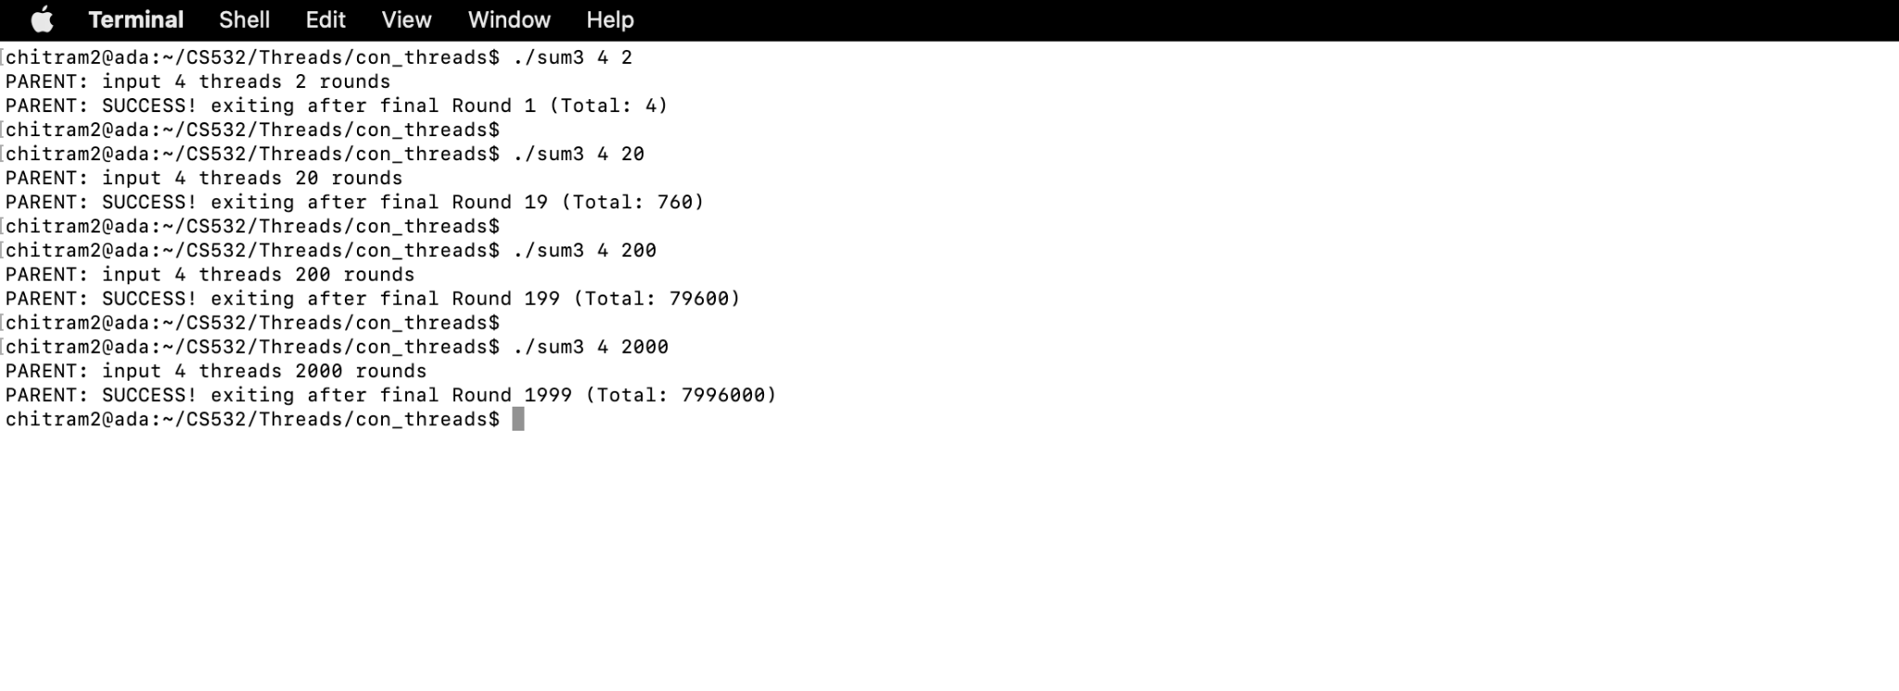

Slide 15
4. Compare the performance of your sum2 vs. sum3 using 4 threads and each of these values for the "Rounds" input: 500, 1000, 2000, 4000, 8000. Construct a line graph comparing the runtime of sum2 vs. sum3 for each Rounds input value. Show your graph on the next page.
(btw, one easy way to measure the runtime of a program on Linux is to run it with the time command like this: time <my command> )

Slide 16
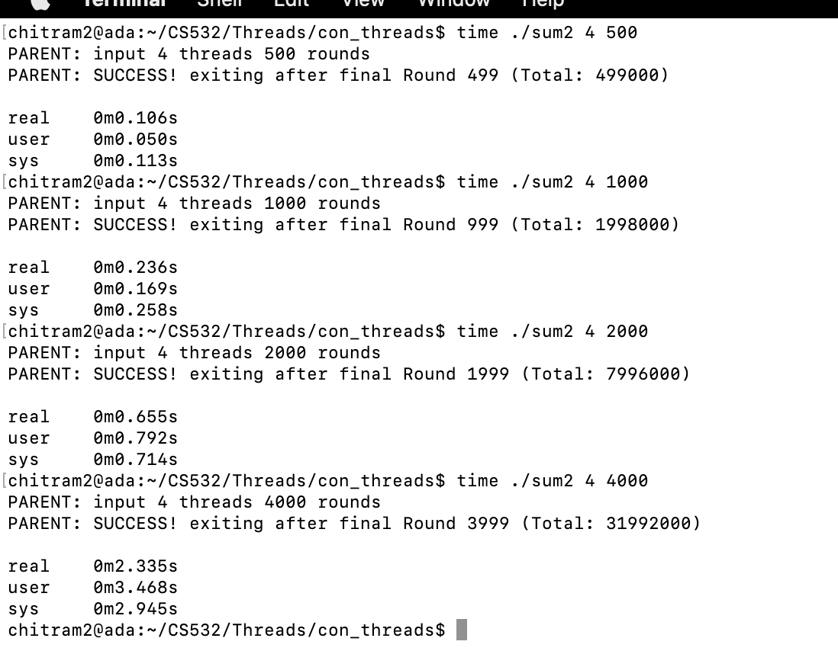

Slide 17
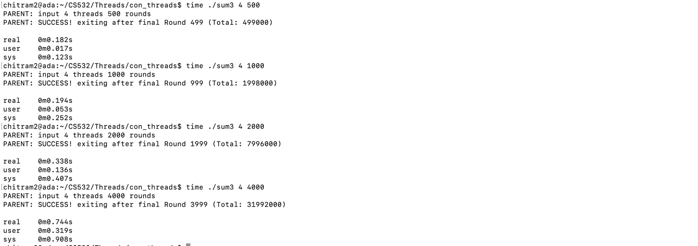

Slide 18
Runtime Comparison of sum2 vs. sum3
Rounds | 500 | 1000 | 2000 | 4000
Time taken by Sum2 | 0.613 | 0.427 | 1.443 | 6.413
Time taken by Sum3 | 0.14 | 0.305 | 0.543 | 1.227
The time is given in the seconds. The number of threads used was constant at 4.
The time given is the sum of user and sys time obtained by using the time.

Slide 19
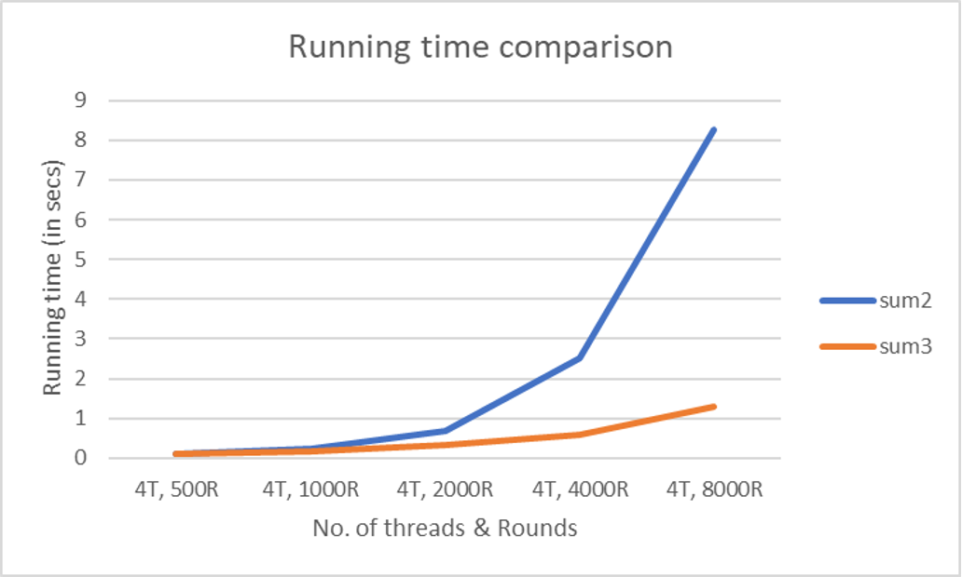
Runtime Comparison of sum2 vs. sum3

Slide 20
5. What conclusions/observations do you make about the two fixed versions, sum2 and sum3?
When the number of rounds input is large, the running time difference between sum2 and sum3 has significant difference. Sum3’s performance is far better than sum2’s performance for larger number of round inputs.

